Slide 1
JENKINS PIPELINE PETSTORE

Slide 2
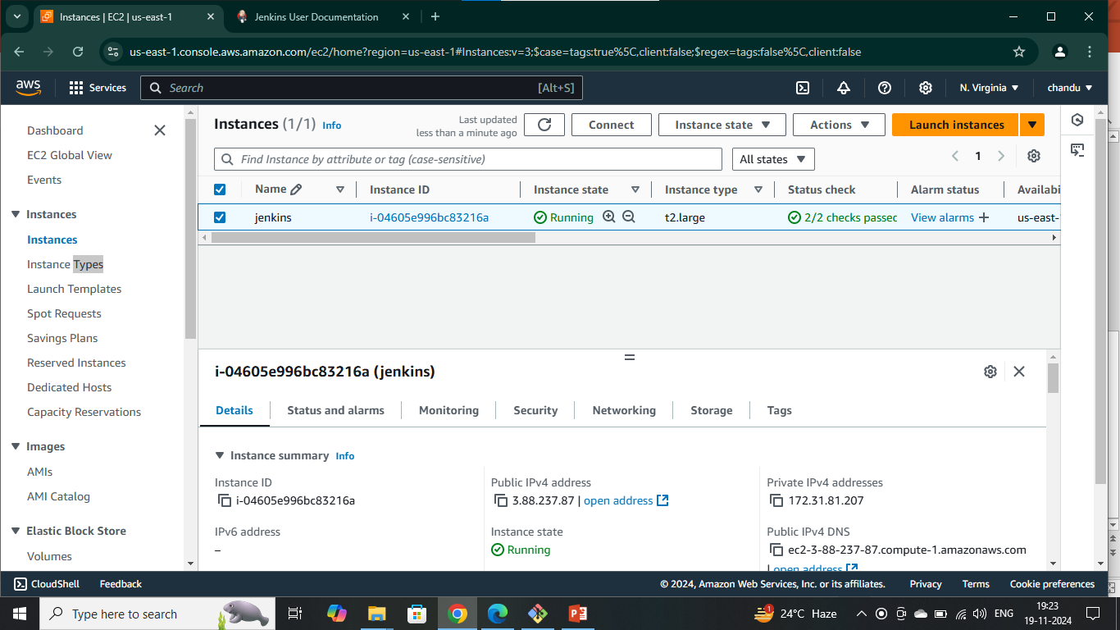
STEP1: Create an Ubuntu (22.04) T2 Large Instance
Launch an AWS T2 Large Instance. Use the image as Ubuntu. You can create a new key pair or use an existing one. Enable HTTP and HTTPS settings in the Security Group and open all ports

